Slide 1
Ticket to ride
By TensorToads
(Nicolas Simard, Émile Deschamps, Simon Roy)

Slide 2
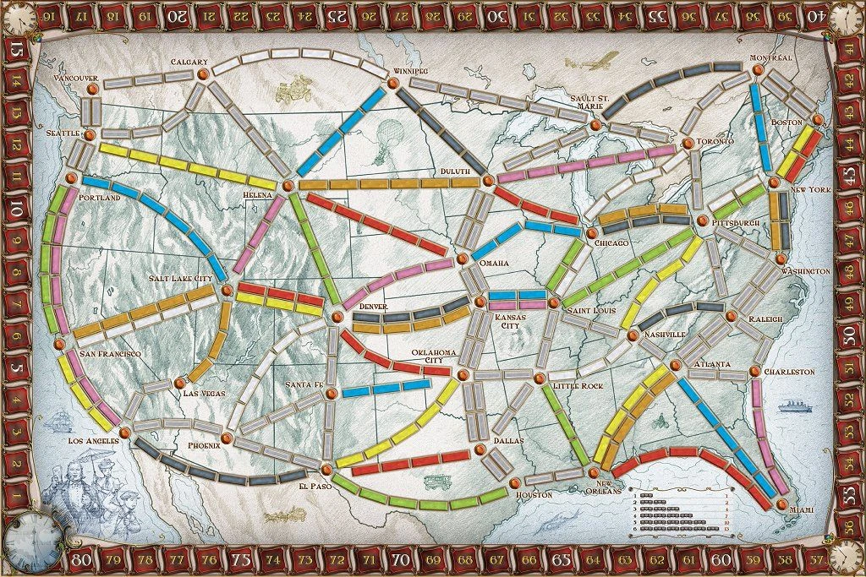
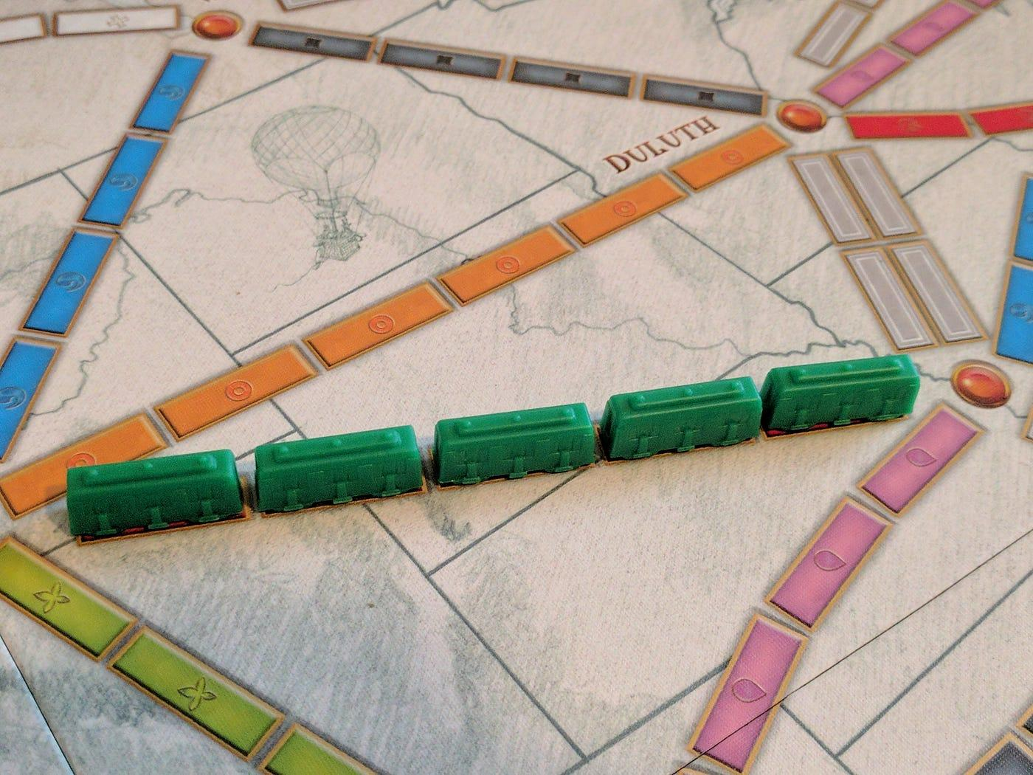
What is the original game ?
Goal :
The person with the most point win !
Connect cities together
Gameplay :
Collect train card
Try to create links between adjacent cities
Collect destination card to get bonus goal

Slide 3
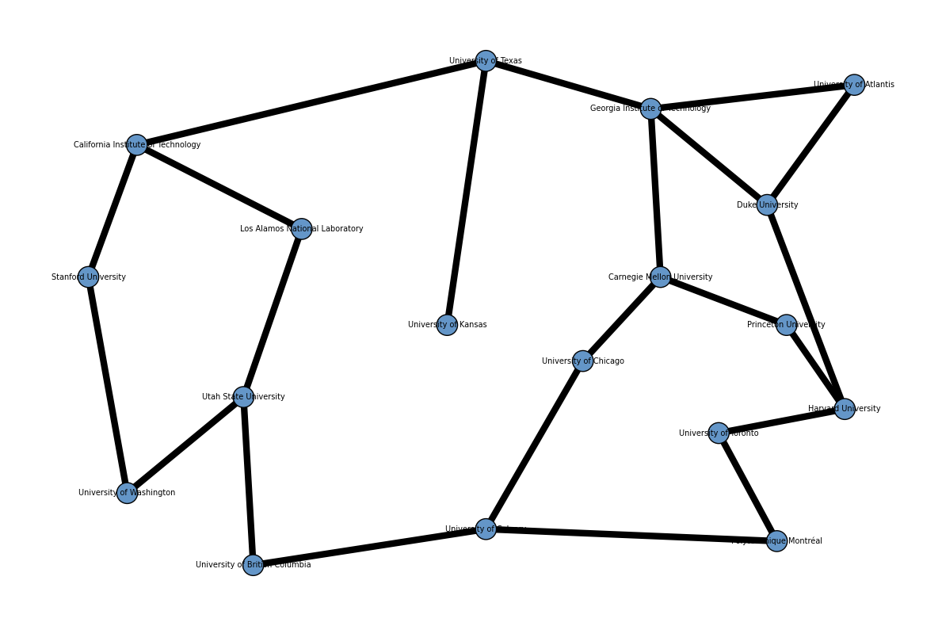
Our quantum skin

Slide 4
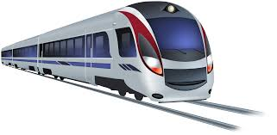
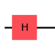
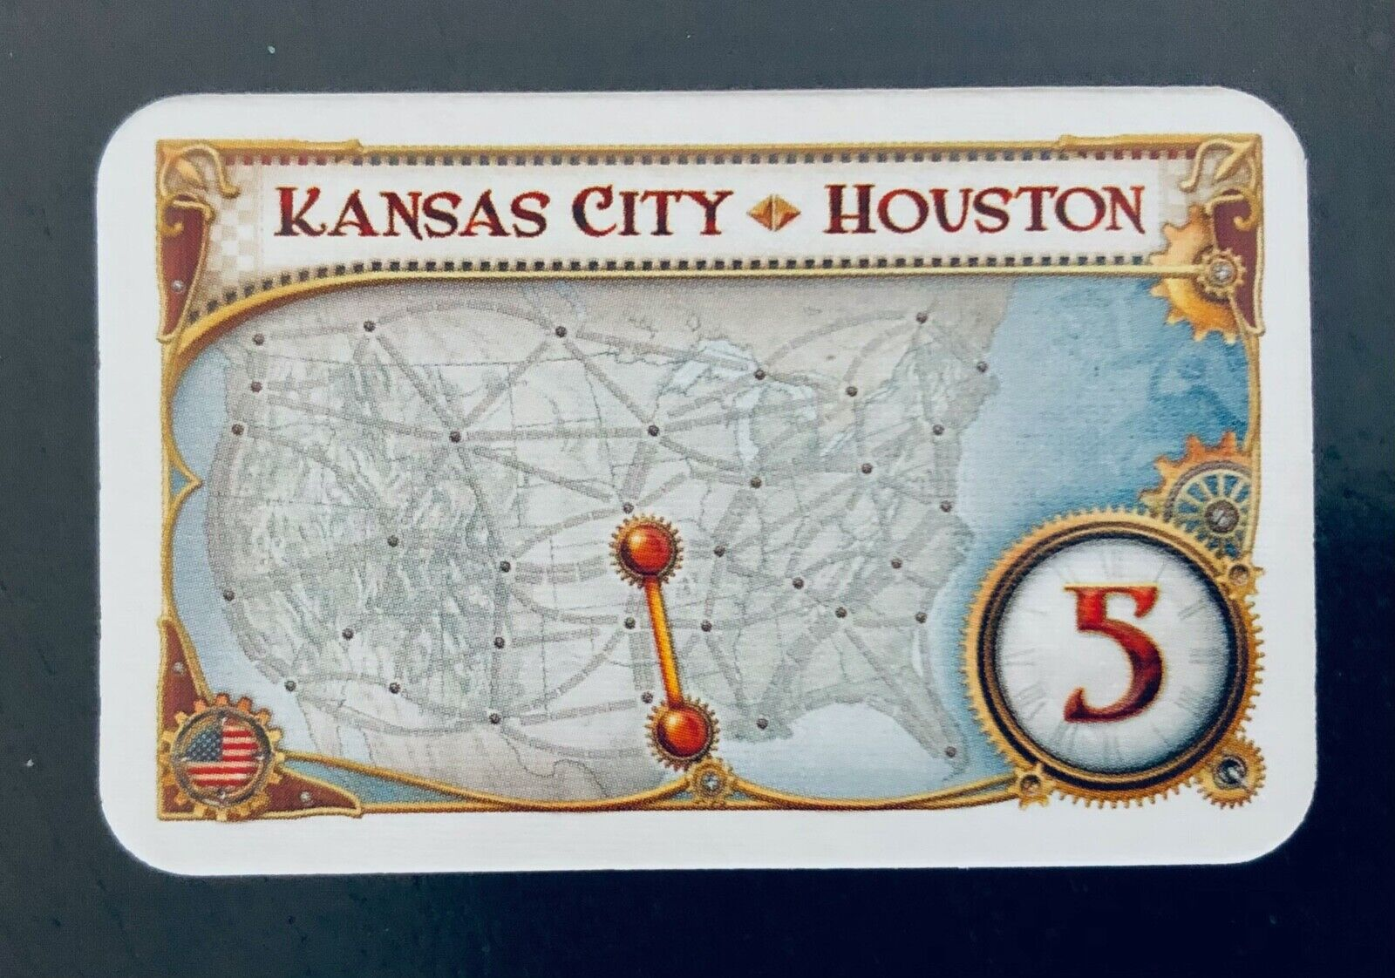
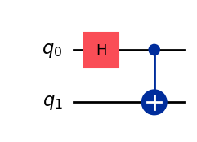
Mission cards
Stranford
U Lost atlantis
MIT

Slide 5

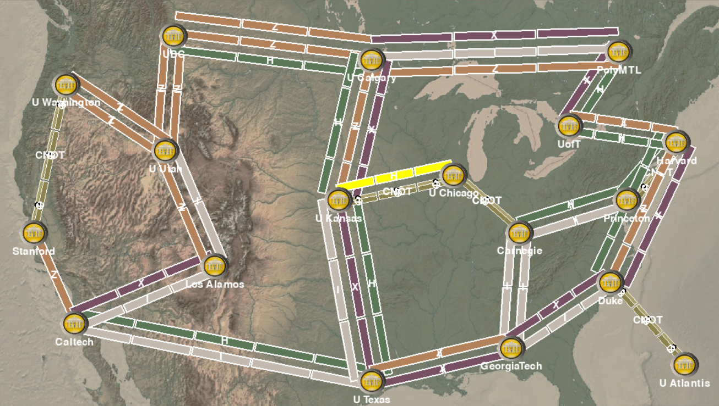
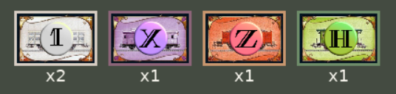
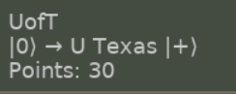
Artistic choices:
The cities are now universities with a new map, cards and missions to complete!

Slide 6
Rules of the game :
Goal : Claim routes between universities to deliver quantum states from one to the other
Build quantum gates between universities using cards
When both target cities are connected, score points if the qubit pair which starts in |0> ends in the right state
Entangle two qubits starting in different cities joining together using CNOT gates

Slide 7
Possibles additions
Entanglement of multiple players, starting from the same city
Quantum measurements as objectives, giving points based on the collapsed state in the end city (which measures according to a predetermined orientation)
Could allow multiple states to score points, but with a higher chance with better states
More gates (might require bigger maps and looser objectives to allow for multiple solutions)
Quantum teleportation !
Your suggestions, dear audience !

Slide 8
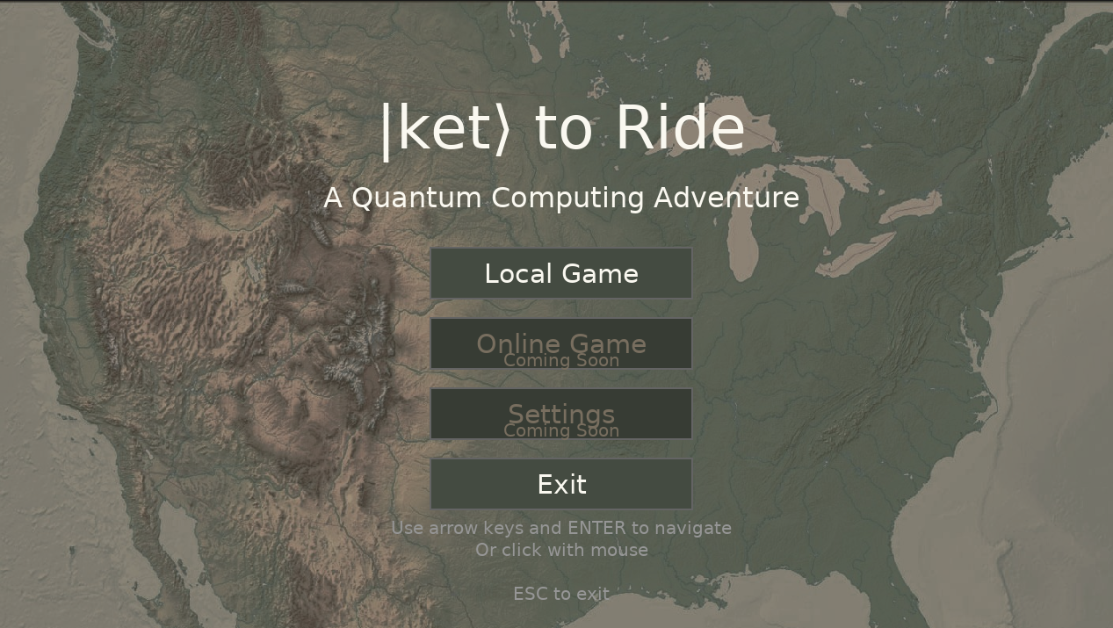
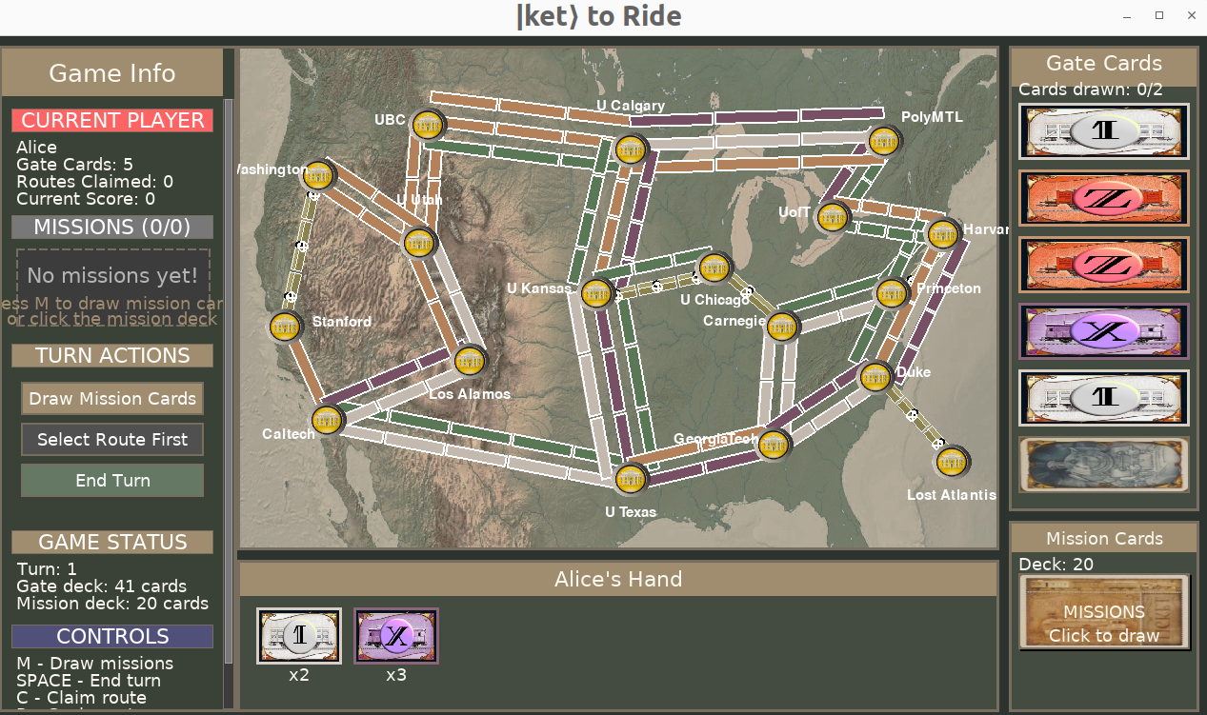
Welcome aboard !

